Slide 1
Dr. Tony Herrera
COURAGEOUS CONVERSATION

Slide 2
History
Concept created by Chris Argyis from Harvard, and Don Schoen from MIT.
Over 40 years of tested global research in 57 countries.
Researchers analyzed the difference between beliefs and actual behaviors in stressful situations.

Slide 3
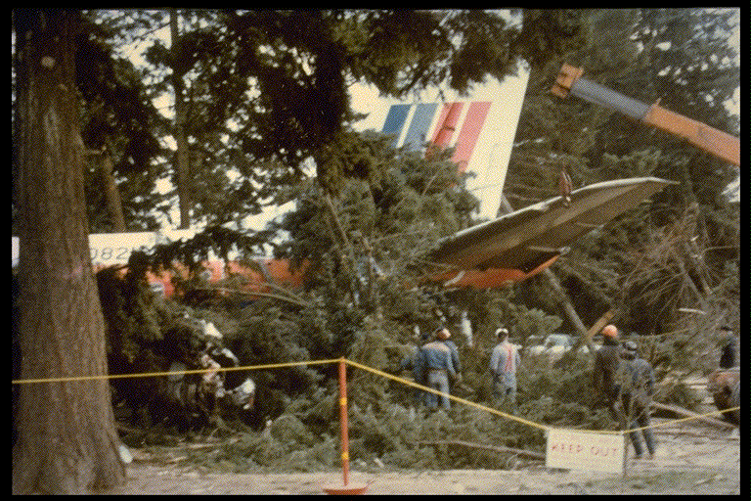
When Leaders Get It Wrong

Slide 4
Why Courageous Conversations
2016 Research Survey of 9,561 employees,
managers and executives from 272 public, private, business and healthcare organizations.
89%
93% of people have avoided challenging issues with a coworker.
89% of people have avoided challenging issues with their boss.
81% of managers have avoided challenging issues with direct reports.

Slide 5
Predictable Behaviors
Minimizing (Flight)
Winning (Fight)
Keep conversation comfortable
Easing in
Withdrawing when difficult
Asking leading questions
Weakening your position
Covering up
Get people to see things your way or that you are right
Arguing
Poor listening
Blaming or finger-pointing
Dismissing others’ views
Adopting a strong position

Slide 6
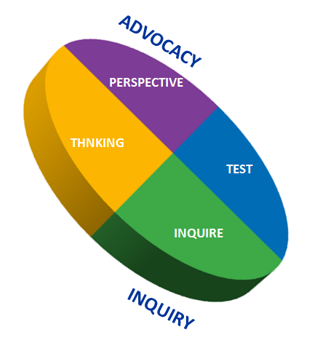
Courageous Conversations Framework
Primer Setting the stage: starting the conversation / establishing expectations
Offers your point of view
Proactively checks
your thinking with the
other person/team
• Invites the other person’s/team’s perspective
Uses data, reasoning, and
the impact of behavior
Explores the other person’s/team’s thinking (data, reasoning)

Slide 7
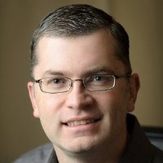
“Million Dollar” Matt

